Slide 1
CS 3006 Parallel and Distributed Computing Lecture 6
Danyal Farhat
FAST School of Computing
NUCES Lahore

Slide 2
Decomposition and Mapping Techniques

Slide 3
Outline
Decomposition Techniques
Recursive Decomposition
Finding the Minimum Number
Recursive Decomposition Example: Quick Sort
Data Decomposition
Exploratory Decomposition
Speculative Decomposition
Hybrid Decomposition

Slide 4
Outline (Cont.)
Mapping Schemes
Static Mapping
Dynamic Mapping
Schemes for Static Mapping
Block distribution (1D)
Block distribution (2D)
Cyclic distribution
Block-Cyclic distribution
Randomized-Block distribution (solution: 1D)
Randomized-Block distribution (solution: 2D)

Slide 5
Outline (Cont.)
Random Distribution
Graph Partitioning
Summary
Additional Resources

Slide 6
Decomposition Techniques
How to decompose a task into various subtasks?
While there is no single recipe that works for all problems, we present a set of commonly used techniques that apply to broad classes of problems. These include:
recursive decomposition
data decomposition
exploratory decomposition
speculative decomposition
General purpose vs. Special purpose
The recursive and data decomposition techniques are relatively general purpose as they can be used to decompose a wide variety of problems.
The speculative and exploratory techniques are more of a special purpose nature because they apply to specific classes of problems.

Slide 7
Recursive Decomposition
Generally suited to problems that are solved using the divide-and-conquer strategy.
A given problem is first decomposed into a set of sub-problems.
These sub-problems are recursively decomposed further until a desired granularity is reached.
A natural concurrency exists as different sub-problems can be solved concurrently.

Slide 8
Finding the Minimum Number
The problem of finding the minimum number in a given list (or indeed any other associative operation such as sum, AND, etc.) can be fashioned as a divide-and-conquer algorithm.
We first start with a simple serial loop for computing the minimum entry in a given list:
1. procedure SERIAL_MIN (A, n)
2. begin
3. min = A[0];
4. for i := 1 to n − 1 do
5. if (A[i] < min) min := A[i];
6. endfor;
7. return min;
8. end SERIAL_MIN

Slide 9
Finding the Minimum Number (Cont.)
procedure RECURSIVE_MIN (A, n) begin if ( n = 1 ) then min := A [0];
else lmin = RECURSIVE_MIN ( A, n/2 ); rmin = RECURSIVE_MIN ( &(A[n/2]), n - n/2 );
if (lmin < rmin) then min = lmin; else min = rmin; endelse; endelse; return min; end RECURSIVE_MIN

Slide 10
Finding the Minimum Number (Cont.)
The code in the previous foil can be decomposed naturally using a recursive decomposition strategy. We illustrate this with the following example of finding the minimum number in the set {4, 9, 1, 7, 8, 11, 2, 12}. The task dependency graph associated with this computation is as follows:

Slide 11
Recursive Decomposition Example: Quick Sort
Once we have selected a pivot value, partitioning places all the elements less than the pivot in the left part of the array and all elements greater than the pivot in the right part of the array and the pivot is in the slot between them.
The pivot element ends up in the position it retains in the final sorted order
After partitioning no element flops to the other side of the pivot in the final sorted order
Thus we can sort the elements to the left of the pivot and the right of the pivot independently

Slide 12
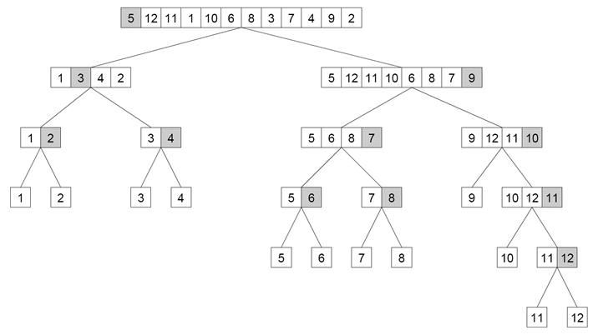
Recursive Decomposition Example: Quick Sort

Slide 13
Quicksort Pseudo-code
Quicksort(A, low, high)
If (low < high)
pivotLocation = Partition(A, low, high)
Quicksort(A, low, pivotLocation - 1)
Quicksort(A, pivotLocation + 1, high)
Partition(A, low, high)
Pivot = A[low]
Leftwall = low
For (i = low +1 to high)
if (A[i] < pivot)
leftwall = leftwall + 1
Swap (A[i], A[leftwall])
Swap(A[low], A[leftwall])

Slide 14
Data Decomposition
Used for deriving concurrency in algorithms that operate on large data structures.
Example: Matrix multiplication
Identify the data on which computations are performed.
Partition this data across various tasks.
This partitioning induces a decomposition of the problem.
Data can be partitioned in various ways - this critically impacts performance of a parallel algorithm.
Often, each element of the output can be computed independently of others (but simply as a function of the input).
A partition of the output across tasks decomposes the problem naturally.

Slide 15
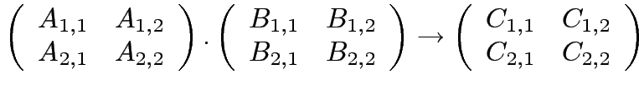




Data Decomposition (Cont.)
Consider the problem of multiplying two n x n matrices A and B to yield matrix C. The output matrix C can be partitioned into four tasks as follows:

Slide 16
Exploratory Decomposition
Search through a predefined space for solution
Search space can be partitioned into tasks which can be processed independently
A simple example is tile puzzle to transform a given initial state to desired final state
Solution algorithm
Subsequent configurations are generated based on current configuration
Each configuration is then explored as an independent task
Tasks induced by exploratory decomposition can be terminated before finishing as soon as desired solution is found by any one task.

Slide 17
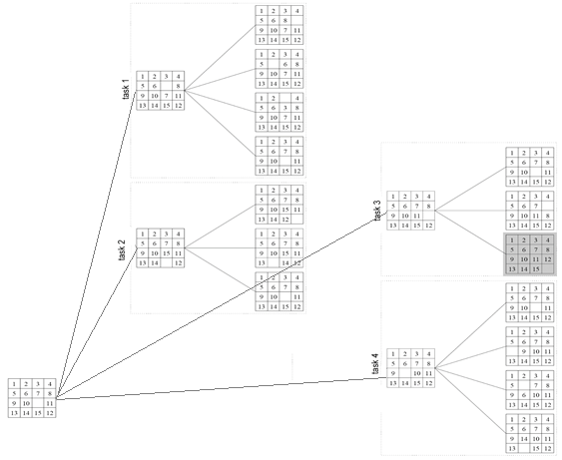
Exploratory Decomposition (Cont.)

Slide 18
Speculative Decomposition
This decomposition is used when a program may take one of many possible computationally significant branches depending on the output of other computations that precede it
Dependencies between tasks are not known a-priori
For example: a switch-statement
These function/s are turned into tasks and carried out before the condition is even evaluated
As soon as the condition has been evaluated, only the results of one task are used, all others, if computed, are thrown away

Slide 19
Speculative Decomposition (Cont.)
Steps:
Speculate (guess) the output of previous stage
Start performing computations in the next stage before even the completion of the previous stage.
After availability of the output of previous stage, if speculation was correct than most of the computation for next step would have already been done.
Switch Example:
Calculate expression for the switch condition -> task 0
Case 0: Multiply vector b with matrix A -> task 1
Case 1: Multiply vector c with matrix A -> task 2
Case 2: Multiply vector d with matrix A -> task 3
display result -> task 4

Slide 20
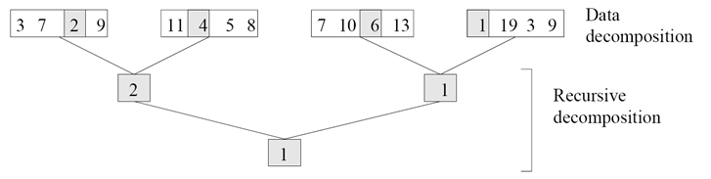
Hybrid Decomposition
Decomposition technique are not exclusive
We often need to combine them together

Slide 21
Mapping Schemes
Static Mapping:
Distributing the tasks among the processes before execution of the program
E.g., usually used in situation where total number of tasks and their sizes are known before the execution of the program
Easy to implement in massage passing paradigm
Dynamic Mapping:
When total number of tasks are not known a priori
(OR) when task sizes are unknown
In this case static mapping can lead to serious load-imbalances

Slide 22
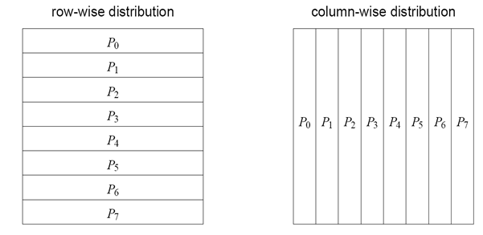
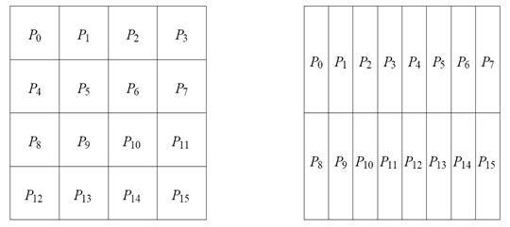
Schemes for Static Mapping
Block distribution (1D)
Block distribution (2D)

Slide 23
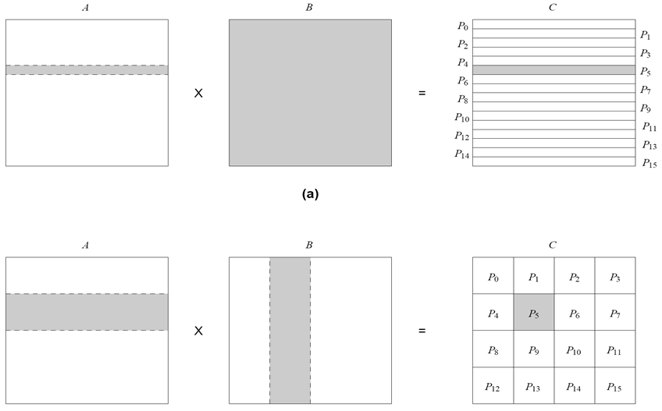
Schemes for Static Mapping (Cont.)

Slide 24
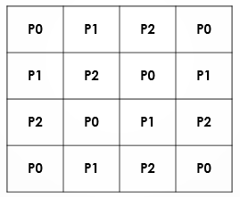
Schemes for Static Mapping (Cont.)
Cyclic distribution (HERE array size=4 x 4 and p=3)

Slide 25
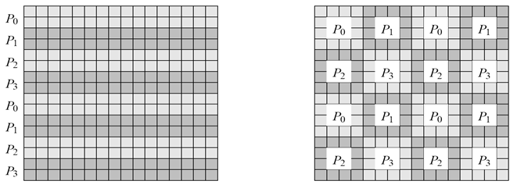
Schemes for Static Mapping (Cont.)
Block-Cyclic distribution

Slide 26
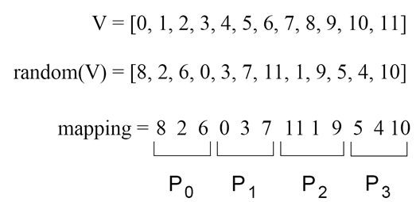
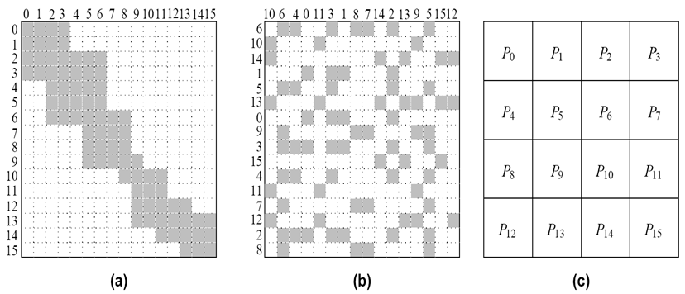
Schemes for Static Mapping (Cont.)
Randomized-Block distribution (solution: 1D)
Randomized-Block distribution (solution: 2D)

Slide 27
Schemes for Static Mapping (Cont.)
Why randomized block cyclic distribution is not always used?
Poor spatial locality
High inter-process interaction

Slide 28
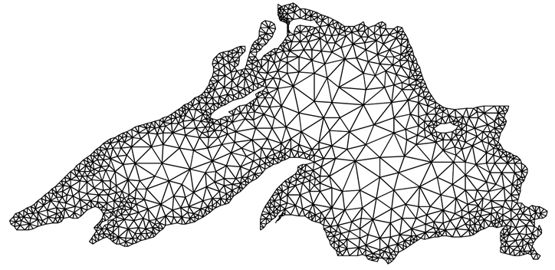
Example
A simulation model (using a mesh of tasks) for finding dispersion of water contaminant in a lake at different intervals of time.

Slide 29
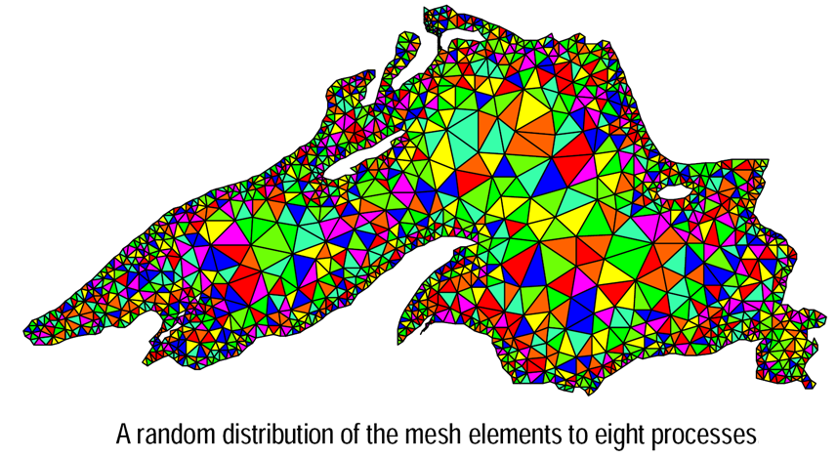
Random distribution

Slide 30
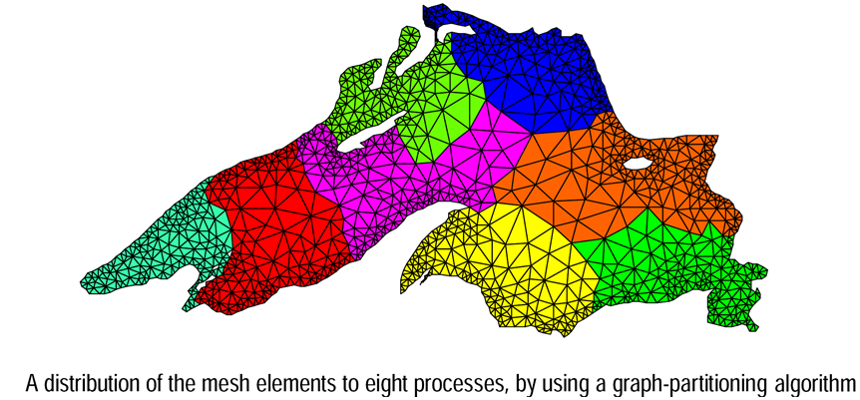
Graph Partitioning

Slide 31
Summary
Decomposition Techniques
No single recipe, multiple techniques, hybrid version can also be used
Recursive Decomposition
Divide and conquer strategy
Examples: Finding the Minimum Number, Quick sort and many others
Data Decomposition
Data of independent tasks is decomposed and mapped on multiple processors for parallel execution
Example: Matrix Multiplication

Slide 32
Summary (Cont.)
Exploratory Decomposition
Search through a predefined space for solution
Example: Tile puzzle
Speculative Decomposition
Speculate (guess) the output of previous stage
Start performing computations in the next stage before even the completion of the previous stage
Example: Switch statement
Hybrid Decomposition
Multiple decomposition techniques can be used simultaneously

Slide 33
Summary (Cont.)
Mapping Schemes
Static Mapping
Tasks distribution among the processes is done before the execution of the program
Total number of tasks and their sizes are known a priori
Dynamic Mapping
Tasks distribution among the processes is done duuring the execution of the program
Total number of tasks and their sizes are not known a priori
Schemes for Static Mapping
1D & 2D Block distribution
Cyclic distribution, Block-Cyclic distribution
1D & 2D Randomized-Block distribution

Slide 34
Summary (Cont.)
Randomized block cyclic distribution is not always used
Poor spatial locality
High inter-process interaction
Random Distribution
A simulation model (using a mesh of tasks) for finding dispersion of water contaminant
Graph Partitioning
A simulation model (using a mesh of tasks) for finding dispersion of water contaminant

Slide 35
Additional Resources
Book: Introduction to Parallel Computing by Ananth Grama and Anshul Gupta
Chapter 3. Principles of Parallel Algorithm Design
Section 3.2: Decomposition Techniques
Section 3.4: Mapping Techniques for Load Balancing

Slide 36
Questions?

